Slide 1
Lending Club – Case Study
upGrad – Submission on Lending Club – Case Study

Slide 2
Approach Taken
Below is the high-level approach taken to solve the case study. Each steps is defined in detail in individual slides.
Data Cleansing
Field Creation
Univariate Analysis
Bivariate Analysis
Observations

Slide 3
Data Cleansing
First approach is to clean the data based on below factors
Empty Fields
Irrelevant Fields
Irrelevant records
Outliers

Slide 4
Field Creation
Creation if additional fields from existing ones like extracting ‘month’ and ’year’ from date field and adding it as separate columns

Slide 5
Univariate Analysis
Univariate analysis will mostly be done on the ‘Charged Off’ records and by using the count of ‘charged off’ loans against different fields we will try to understand patterns.
As part of this slide only relevant charts will be included

Slide 6
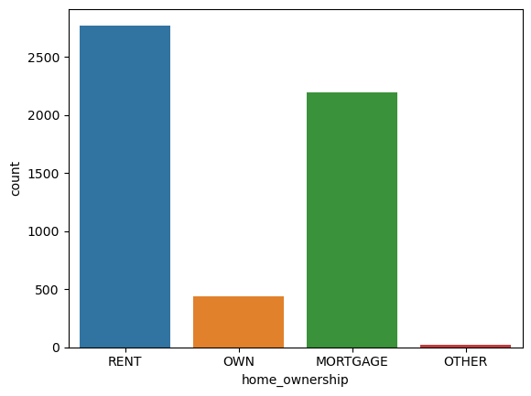
Univariate Analysis (Contd..)

Slide 7
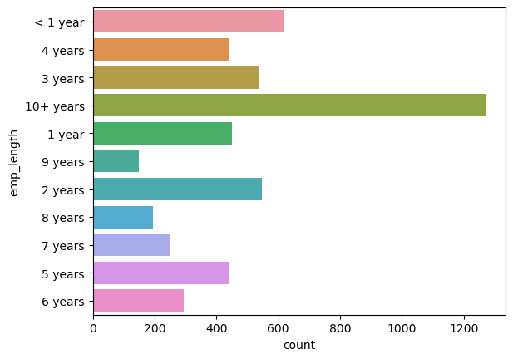
Univariate Analysis (Contd..)

Slide 8
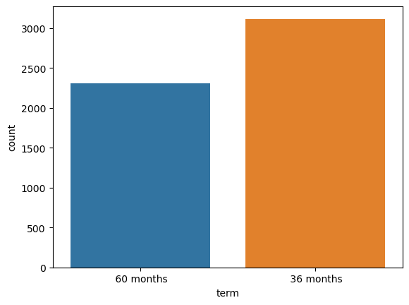
Univariate Analysis (Contd..)

Slide 9
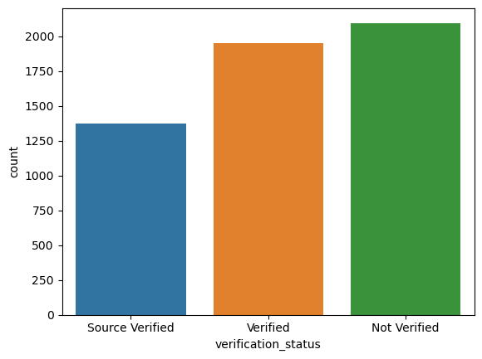
Univariate Analysis (Contd..)

Slide 10
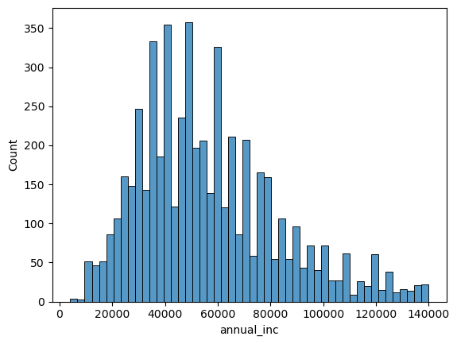
Univariate Analysis (Contd..)

Slide 11
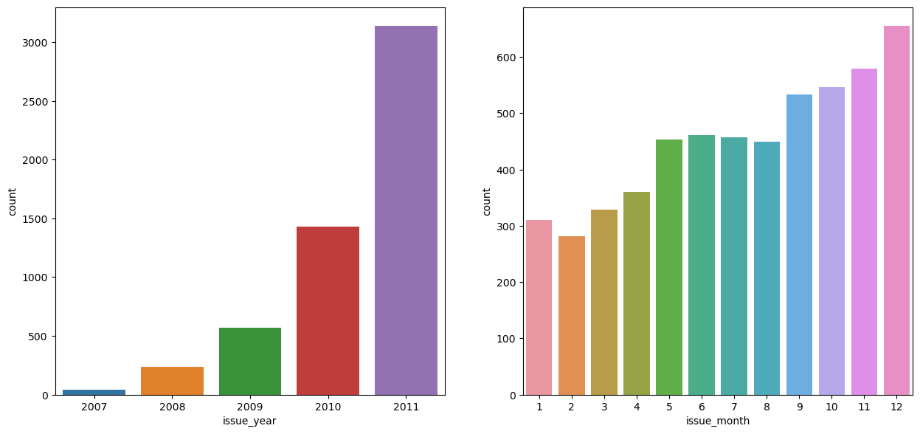
Univariate Analysis (Contd..)

Slide 12
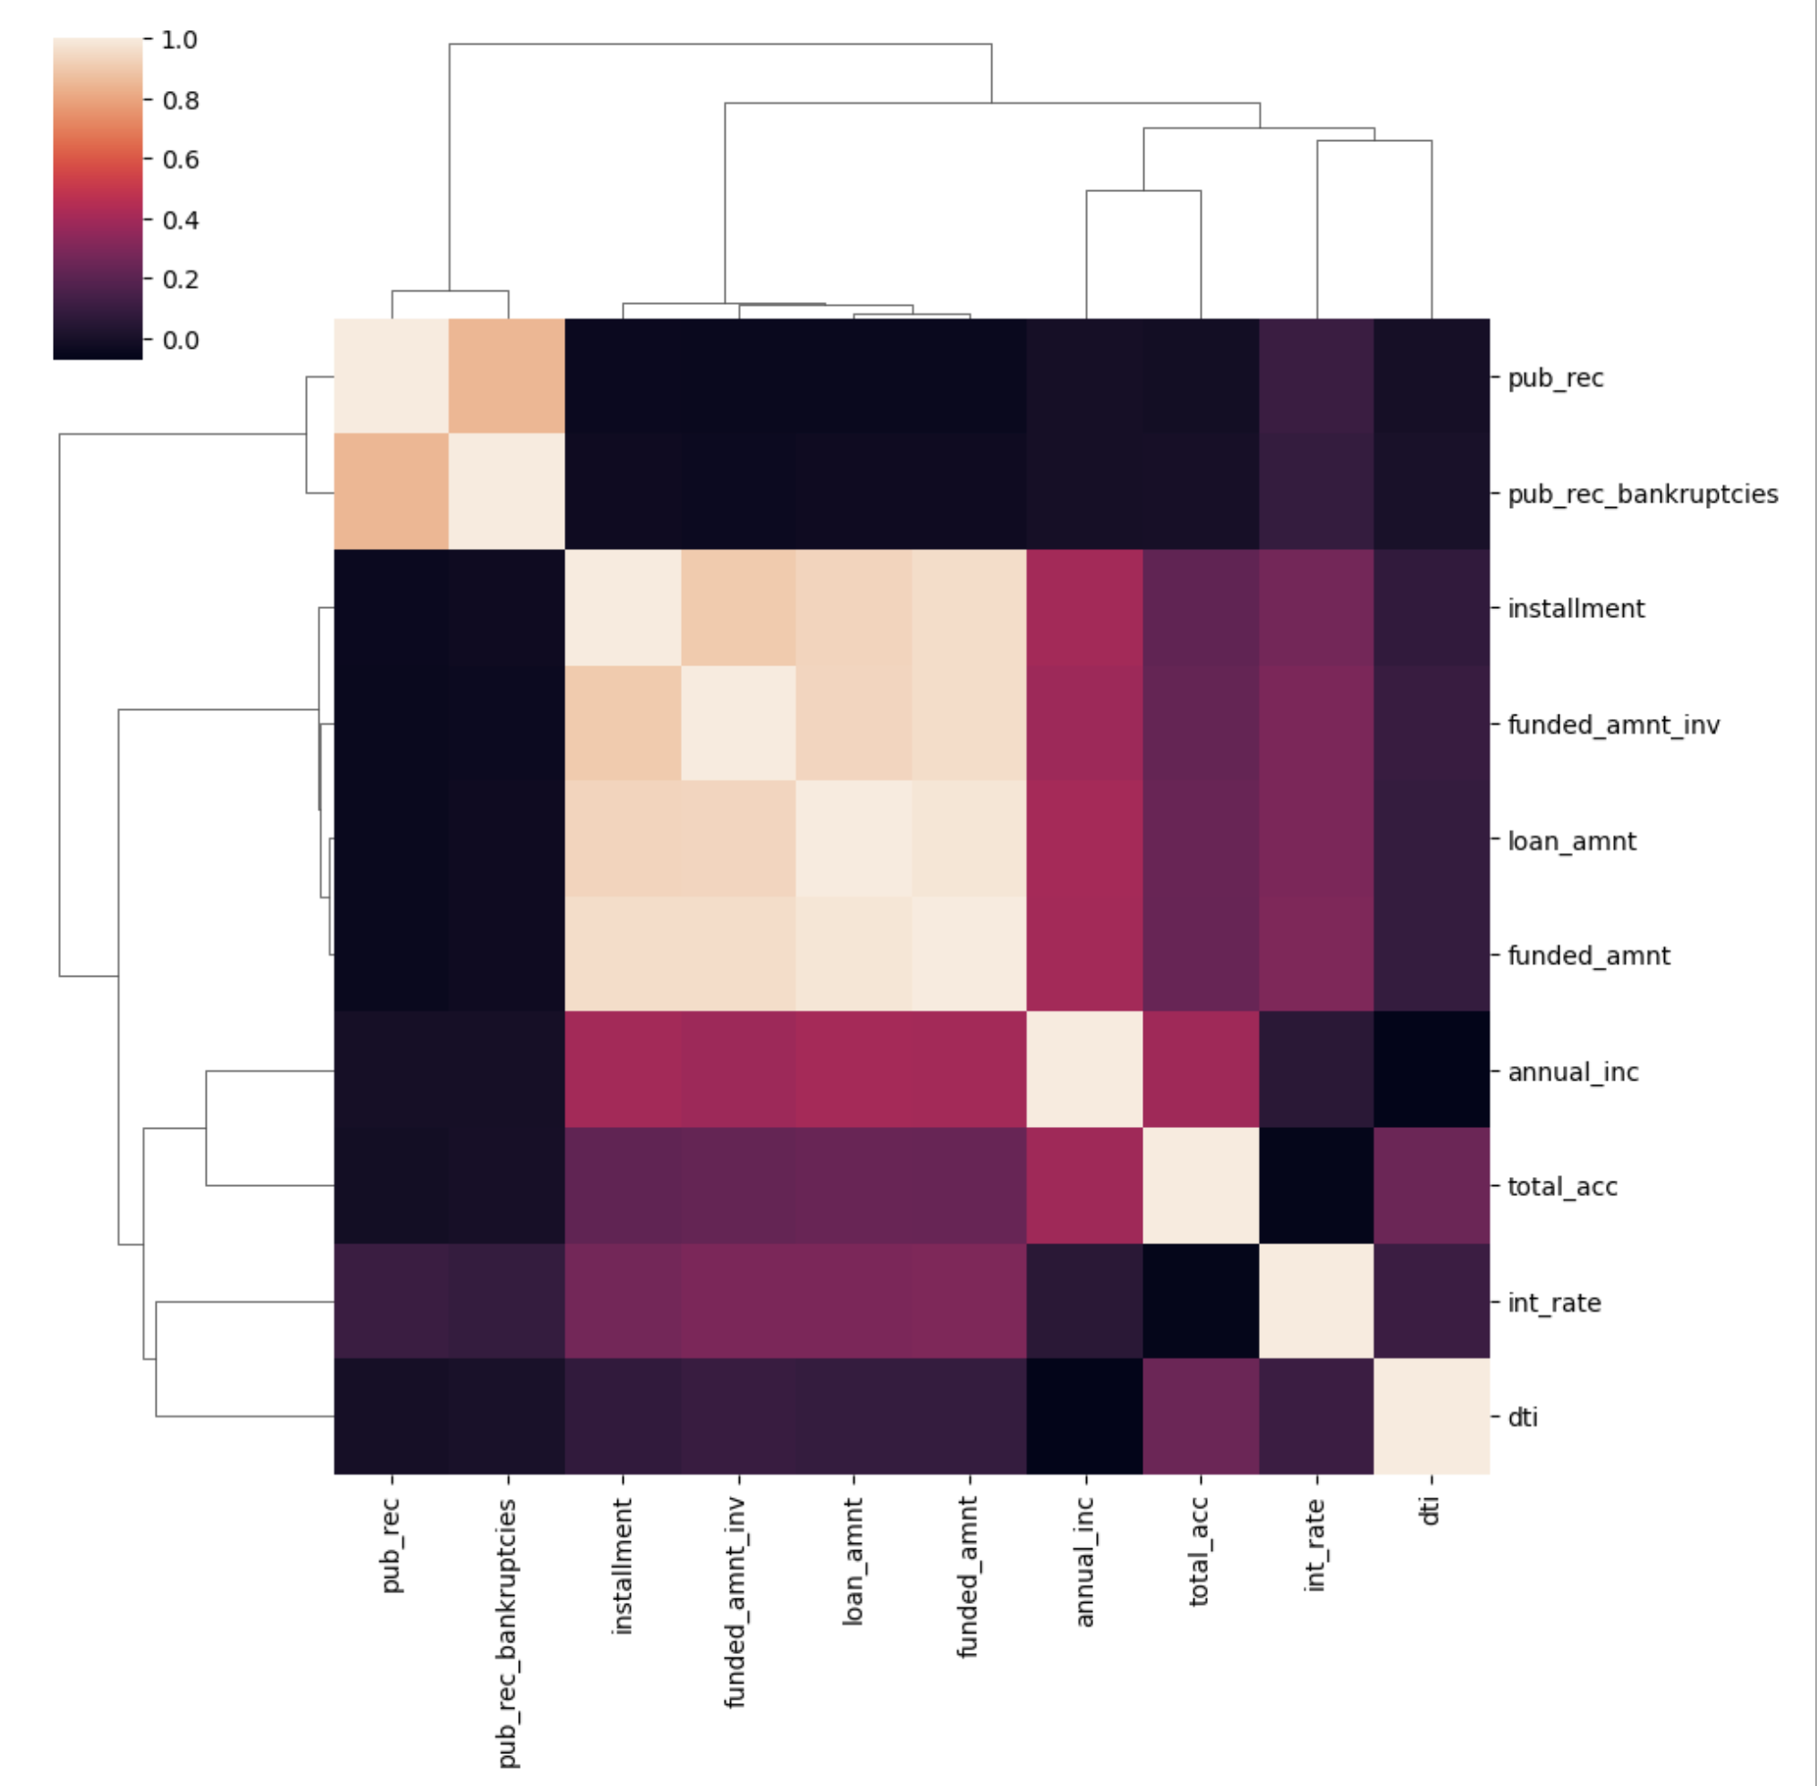
Bivariate Analysis

Slide 13
Observations
Based on correlation graph below are the observations
There is high degree of correlation between 'pub_rec' and 'pub_rec_bankruptcies'
There is high degree of correlation between 'installment', 'funded_amnt_inv', 'loan_amnt' and 'funded_amnt'
Based on above countplots the probablity of customers defaulting is when
Customers having house_ownership as 'RENT'
When the purpose is 'debt_consolidation'
Customers with employement length of 10
Customers availaing term of 36 months
When the loan status is 'Not verified'
When the number of derogatory public records is 0
When the 'annual_inc' is in the range of 35K - 60K appx

